Slide 1

STAT 5 DISCUSSION
TA: Yongqi Chen
Email: ychen574@ucsc.edu
Office hour: Mon 1PM - 2PM (BE 151) & Tue 11 AM – 12 PM (BE 151)

Slide 2
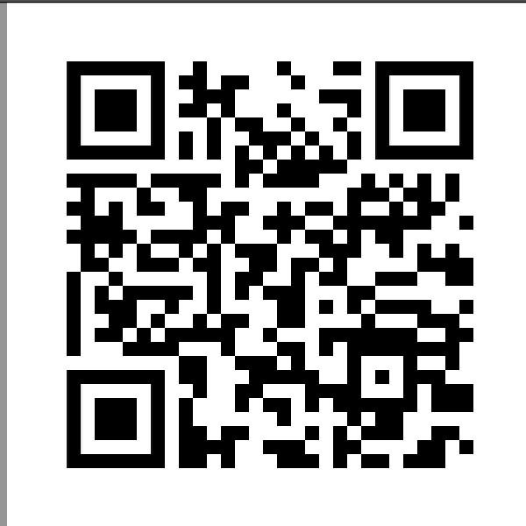
For today’s discussion…
Solve some assignment problems → It’s ok if you haven’t read all the reading assignments. We will go over some of the concepts together through solving assignment problems.
If you have questions, feel free to ask!

Slide 3
Associations
Positive association: upward trend
Negative association: downward trend
Linear relationship: straight-line relationship between two variables
Nonlinear relationship: curve relationship between two variables

Slide 4
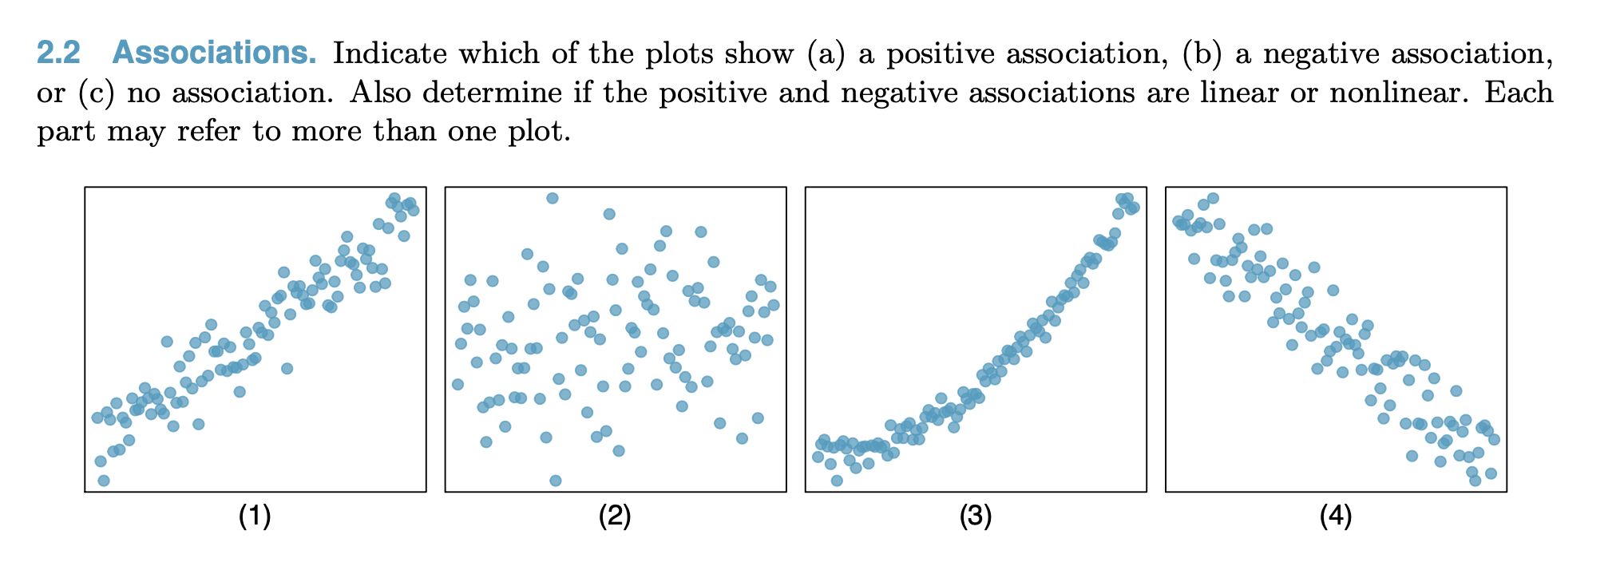
Assignment 2 Problem 2.2

Slide 5
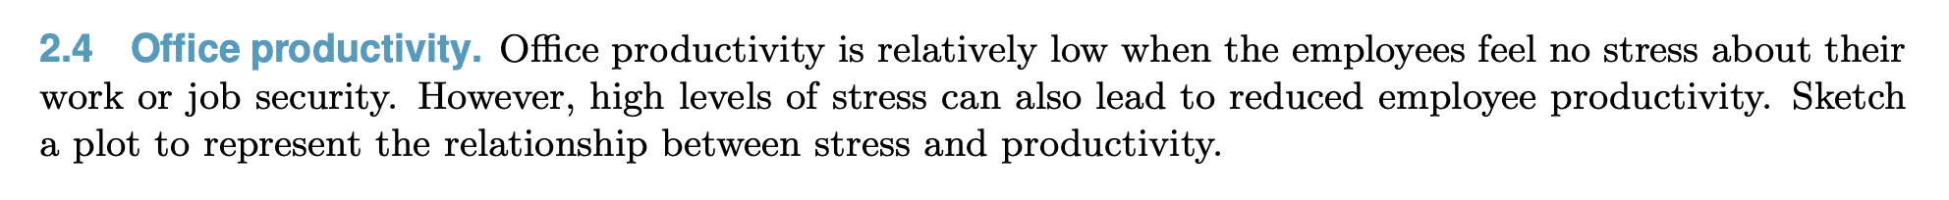
Assignment 2 Problem 2.4

Slide 6
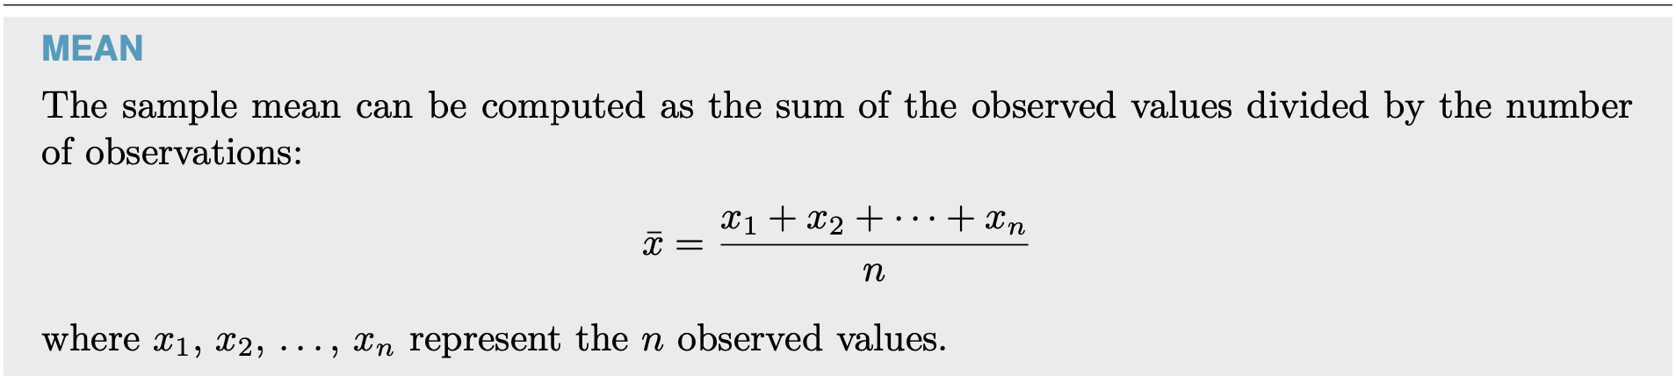
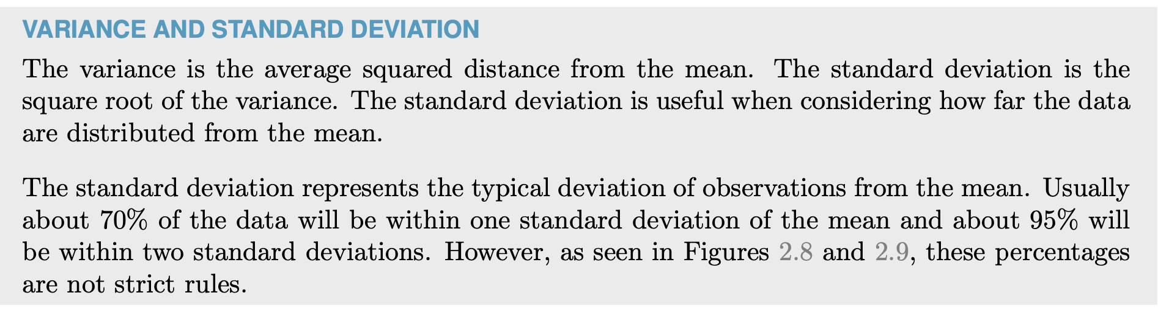
Assignment 2 Problem 2.9

Slide 7
Assignment 2 Problem 2.9
More about SD:
The SD says how far away numbers on a list are from their average.
Roughly 68% of the entries on a list are within one SD of the average, the other 32% are further away. Roughly 95% are within two SDs of the average, the other 5% are further away.
Formula:

Slide 8
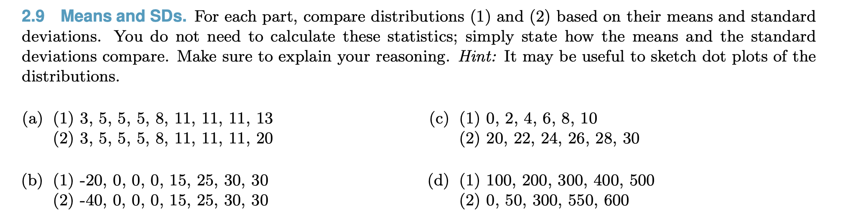
Assignment 2 Problem 2.9

Slide 9
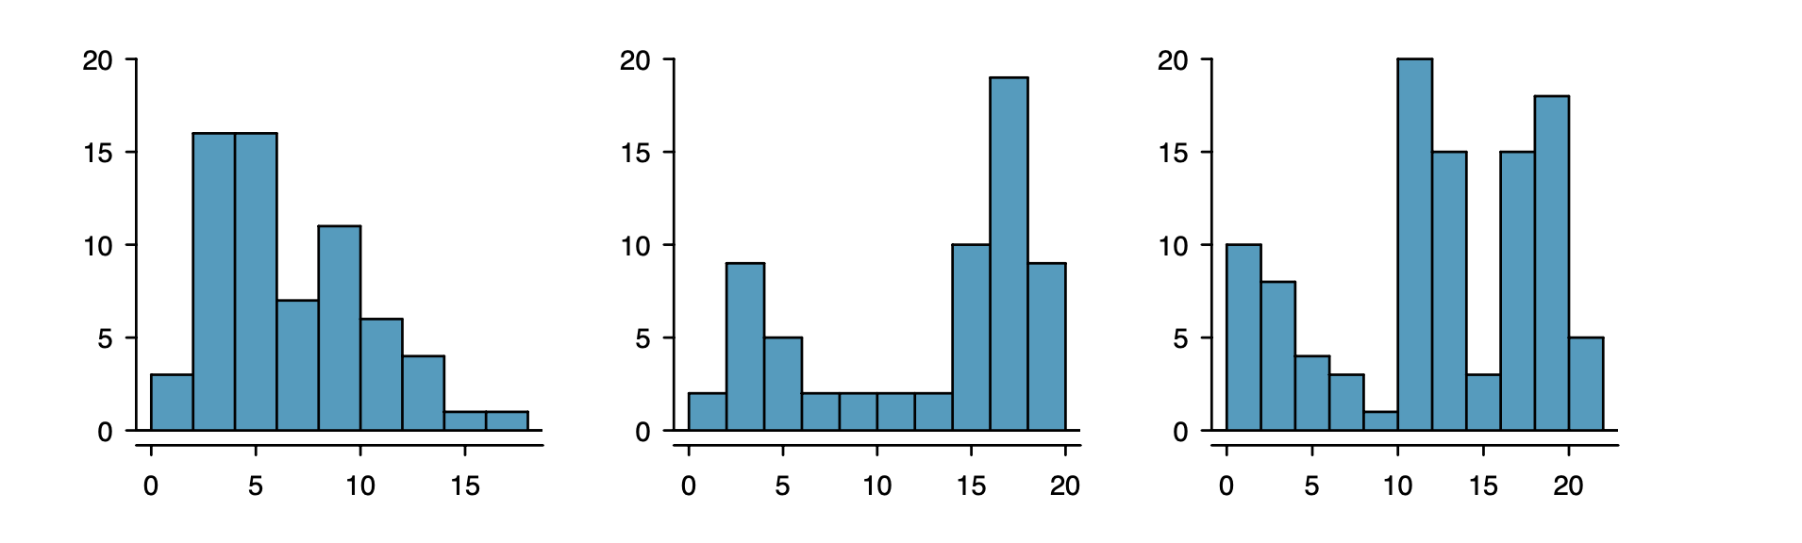
Assignment 2 Problem 2.13
Unimodal
Bimodal
Multimodal
One prominent peak
Two prominent peak
Three Prominent Peak

Slide 10
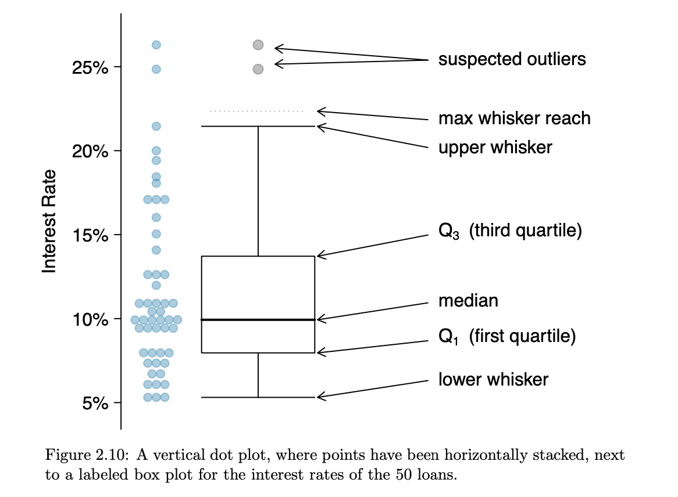
Assignment 2 Problem 2.13

Slide 11
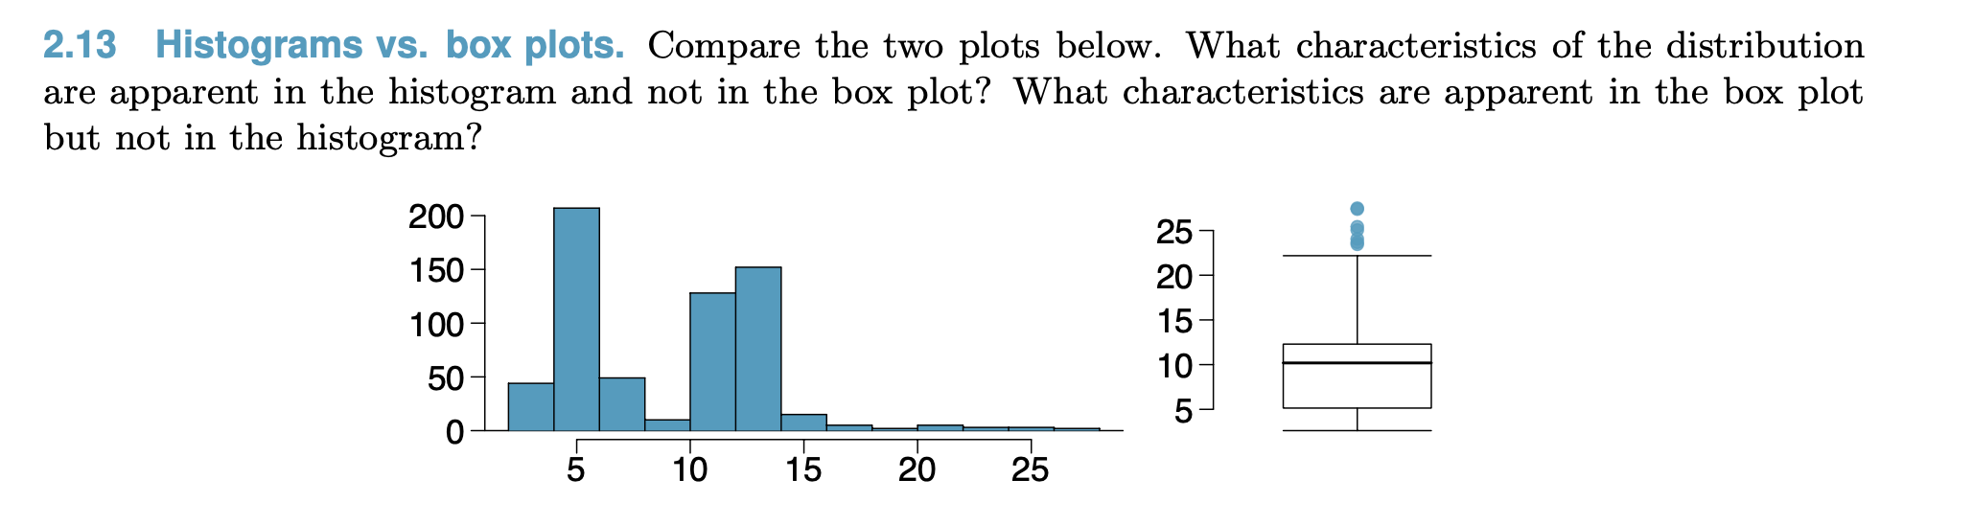
Assignment 2 Problem 2.13

Slide 12
Assignment 2 Problem 2.14
Right skewed VS left skewed

Slide 13
Assignment 2 Problem 2.18
The median and IQR are called robust statistics: extreme observations have little effect on their values: moving the most extreme value generally has little influence on these statistics.
The mean and standard deviation are heavily influenced by changes in extreme observations. (not robust statistics)

Slide 14
Assignment 2 Problem 2.18

Slide 15
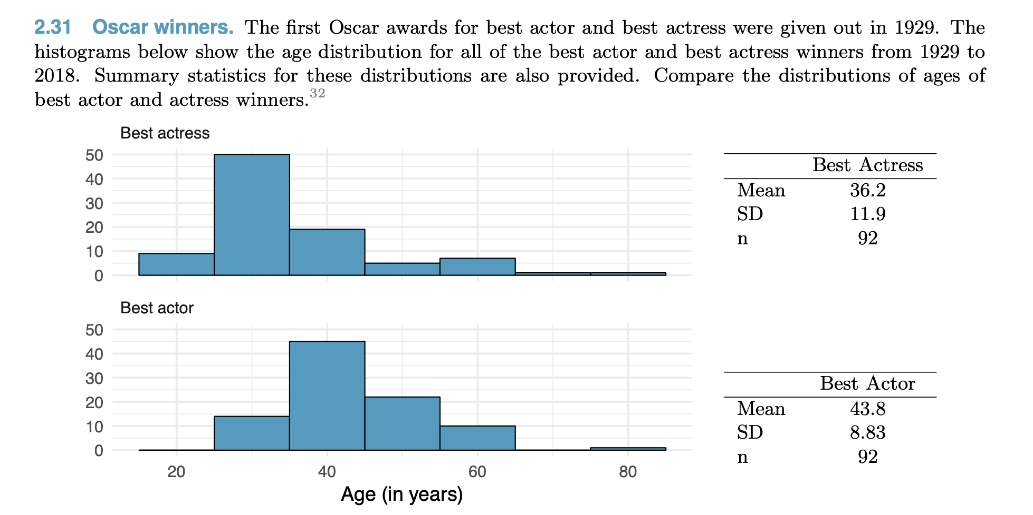
Assignment 2 Problem 2.31

